Slide 1
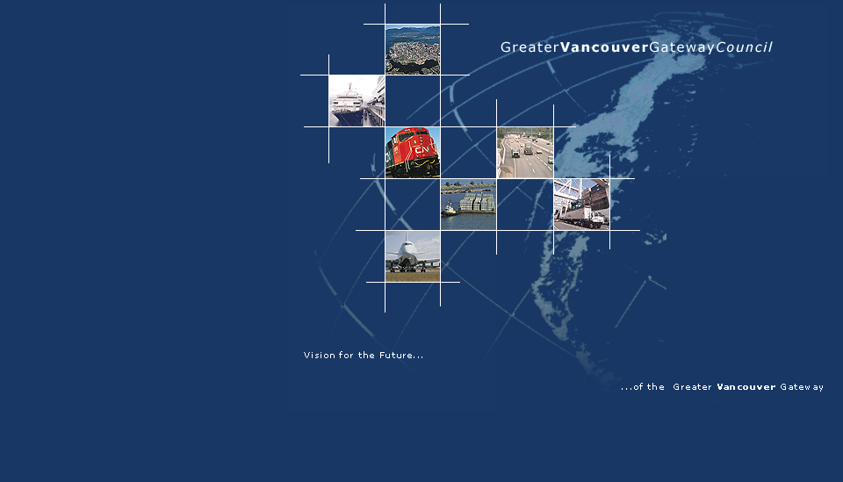
Enhancing Planning Capacity in the Asia Pacific Gateway
Presentation to MRTAC
November, 2012
Notes:
Thank you for the invitation to attend your meeting and speak with you today about the results of a study that I chaired for the APGST.

Slide 2
Presentation Objectives
Present the results of the study on “Enhancing Planning Capacity in the Asia Pacific Gateway”
Confirm the Gateway partners’ commitment to working with local and regional governments
Receive input from MRTAC on opportunities to implement the recommended directions
Notes:
The presentation will tell you a little bit about our Council and highlight the results of the study confirm that our executive is committed to working with local and regional governments and more importantly to get your input on the study results and opportunities for implementing the recommendations.

Slide 3
About the Greater Vancouver Gateway Council
Industry-led organization established in 1994
Vision:
  “Greater Vancouver will be a world transportation gateway benefitting from opportunities for expanding world trade and tourism.”
Mandate includes implementing recommendations from the ‘Enhancing Planning Capacity’ report contingent upon available funding.
Notes:
Our activities actually began in 1987 as the Roundtable on Transportation and at that time we were focusing on what could be done to recover much of the cargo that had been lost to Seattle and Tacoma. We spent from 1987 to 1994 focusing on the need for more competitive rail service. We were successful in achieving reduce taxation on fuel in a number of western provinces, improved capital cost allowance rules for railways and reduced property taxes in BC.
Since 1994 we expanded our membership and examined what was required to become the gateway of choice for north America. We produced a vision document that was published in 1999 that identified infrastructure and policy and regulatory matters that we felt were required to achieve our Vision.
Actually the last time I met with this group was to present our Major Commercial Transportation system that we had developed that has become the Gateway projects that have been built or are under construction or being considered for future implementation.
We updated our Vision document in 2007 and are in the process of completing the next update including details of the economic impact of the gateway.
More info about our Council including studies we have conducted including economic impact data is available at www.gvgc.org

Slide 4
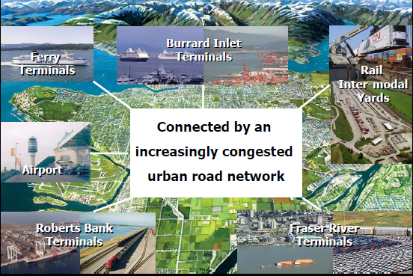
About the Asia Pacific Gateway
~75% (by value) of Canada’s exports to Asia were shipped through BC’s ports.
Gateway capacity will increase from $35 billion to $75 billion worth of cargo by 2020.
Notes:
Includes airports, ports and related facilities such as railways and transportation networks, hubs and distribution centers.

Slide 5
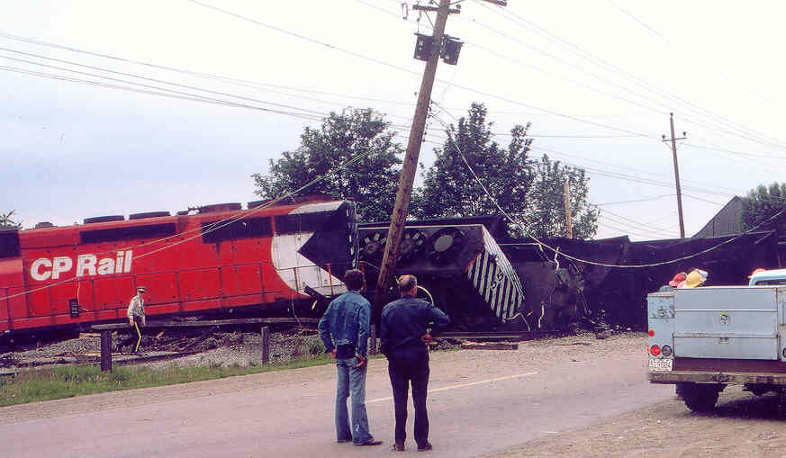
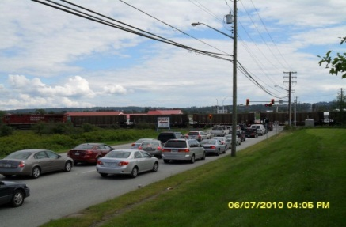
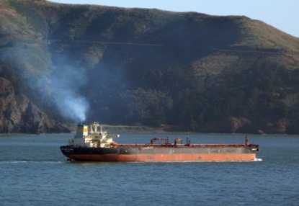
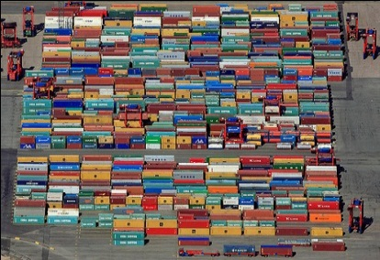
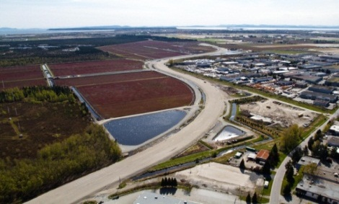
Challenges of Expanding the Gateway
Expanding the Gateway to meet demand for increased trade and economic development presents challenges for:
  Planning and managing transportation systems
  Coordinating land use plans and activities
  Protecting and enhancing the environment
  Addressing priorities for regional and community development.
Notes:
The gateway has not been seen as a continuous system but has been viewed as a number of different projects in this region. We have not done a good job of educating the various audiences about what the Gateway is and why it is important. That became clear to us when we conducted a number of focus groups from different areas of the region a couple of years ago. Since that time we have been raising the need for better coordination of planning and education of the public on the importance of the Gateway with both the Federal and Provincial Governments. There needs to be better understanding of what the Gateway is and why it is important. We also need better coordination between all parties that have a role to play in planning and development in the region that is impacted by the gateway.

Slide 6
Enhancing Planning Capacity Study
The APGST initiated a study in 2010 to address:
  How to improve coordination and integration of planning activities in the Metro Vancouver Region
  Resource requirements to build a greater understanding of the Gateway
  Requirements for training and education for those responsible for planning that may impact the Gateway
Notes:
Recognizing that the Gateway will grow significantly, and the challenges that come from that growth, the APGST initiated a study in 2011 to explore the level of awareness and understanding of the Gateway, and the opportunities for integrating Gateway planning with regional and municipal planning.

Slide 7
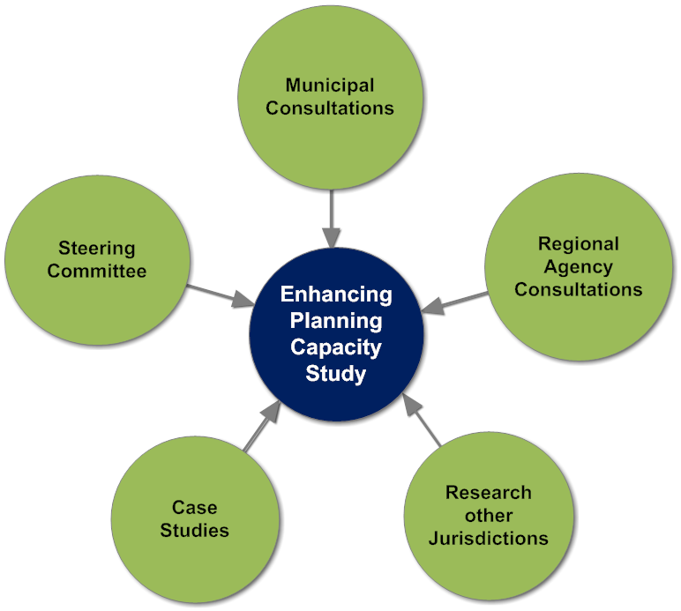
Research and Consultations to Inform the Study
30 planners and professionals (Appendix 1 )
First Nations (2)
Planning Institute of BC
SFU City Program
APEGBC
UBC
Metro Vancouver
Regional Planning Advisory Committee
TransLink
Ports of Rotterdam and Savannah
Notes:
As you can see from this slide the consultation process was very inclusive and I believe a number of your committee were included in the process. All those consulted are listed in Appendix A of the study.

Slide 8
Enhancing Planning Capacity Priorities
Gateway Leadership
Gateway Vision and Plan
Gateway Plan Integration
Communication
and
Engagement
Skill Development
And
Training
Notes:
Research and consultations identified 5 key areas that need to be addressed to improve coordination and integration of planning activities

Slide 9
Gateway Leadership – What we Heard
“The Asia Pacific Gateway needs to take charge, sort out who they are, and they need a contact person that planners can talk to.”
Key Areas for Action
  Stronger leadership and identity
  Improved coordination of Gateway partners
  Entity for working with regional and municipal governments
Notes:
Part of the difficulty in Gateway Leadership has stemmed from the roles of the Federal and Provincial Governments. They have both made substantial financial contributions and obviously want to ensure that they receive maximum credit. Unfortunately involvement and use of different branding has led to confusion of the public. If we hope to address this matter we think that there should be a one stop shop where anyone could go to obtain accurate and timely information about the gateway.

Slide 10
Gateway Leadership Actions
Greater Vancouver Gateway Council will provide leadership and guidance on behalf of the Gateway Partners.
  Gateway vision and integrated plan
  Communications and engagement
  Facilitating plan integration
  Point of contact for information on the Gateway
  Supporting Gateway partners in planning and project implementation
Notes:
It was suggested that our Council could provide the suggested leadership in moving this initiative forward. Our executive have agreed with this assuming we can obtain the necessary funding required to meet this mandate.

Slide 11
Gateway Vision and Plan –
What we Heard
“There has to be a transparent long-term plan for the Gateway so municipalities aren’t constantly reacting to new, time sensitive initiatives.”
Key Areas for Action
  Consolidating Gateway Partners’ plans and priorities into one plan for the southern corridor
  Facilitate the communication and integration of the Gateway Vision and Plan with the planning community
  Tie plans to an economic strategy for the region
Notes:
Multiple Gateway plans preclude an integrated and common understanding of the :
Gateway network
Gateway priorities
Benefits to the Region
How to engage in the Gateway planning
We believe that a economic strategy for the region is long overdue

Slide 12
Gateway Vision and Plan Actions
Integrate Gateway Partner’s plans and priorities into one comprehensive plan for the southern corridor
Present the Gateway Vision and Plan to Metro Vancouver and TransLink political and technical committees
Proactively engage regional and municipal governments in understanding the plan
Notes:
Multiple Gateway plans preclude an integrated and common understanding of the :
Gateway network
Gateway priorities
Benefits to the Region
How to engage in the Gateway planning

Slide 13
Integrate Gateway Planning - What we Heard
“It would be great if the Gateway plans could be drilled down to the OCP level to help the Gateway strategy transcend local politics.”
Key Areas for Action
  Improved engagement of regional and municipal governments when developing Gateway plans
  Integration into regional and municipal plans
  More active representation and participation in ongoing regional planning processes
Notes:
Multiple Gateway plans preclude an integrated and common understanding of the :
Gateway network
Gateway priorities
Benefits to the Region
How to engage in the Gateway in planning

Slide 14
Integrate Gateway Planning - Actions
Work with Translink to establish a Regional Goods Movement Council and strategy
Actively participate in the Regional Transportation Strategy
Confirm participation in the Regional Planning Advisory Committee
Initiate a dialogue on regional economic sustainability with Metro Vancouver
Notes:
Multiple Gateway plans preclude an integrated and common understanding of the :
Gateway network
Gateway priorities
Benefits to the Region
How to engage in the Gateway in planning

Slide 15
Integrate Gateway Planning - Actions
Improve communications with municipal governments on Gateway plans and projects
Conduct work sessions with municipalities (or sub-regions) on plan integration
  Integrate plans at the OCP level
Work closely with municipalities on public engagement for Gateway projects
Notes:
Multiple Gateway plans preclude an integrated and common understanding of the :
Gateway network
Gateway priorities
Benefits to the Region
How to engage in the Gateway in planning

Slide 16
Engagement and Communications – What we Heard
“There is no process to bring people along. There is just too much public relations communications and not enough engagement”
Key Areas for Action
  Improve access to information about the Gateway
  Understanding the benefits of the Gateway
  Improve the approach to working with the public in municipalities
Notes:
Multiple Gateway plans preclude an integrated and common understanding of the :
Gateway network
Gateway priorities
Benefits to the Region
How to engage in the Gateway in planning

Slide 17
Engagement and Communications - Actions
Better define and make available information on the economic role of the Gateway
Implement a Gateway communications program
  Proactive presentations and information
  Branding, website development
  Information on Gateway plans, projects, benefits and technical data
Annual workshop for planners and professionals
Notes:
Multiple Gateway plans preclude an integrated and common understanding of the :
Gateway network
Gateway priorities
Benefits to the Region
How to engage in the Gateway in planning

Slide 18
Knowledge, Skills and Abilities - What we Heard
“There needs to be more education at all levels, including current senior planners and planners in training.”
Key Areas for Action
  Professional development courses on
    Regional and municipal planning processes for Gateway planners and professionals
    Integrating Gateway plans with regional and municipal plans
    Understanding municipal approval and decision-making processes.

Slide 19
Knowledge, Skills and Abilities - Actions
Educational outreach program for planners and professionals through professional organizations (PIBC) and extension courses :
  Introduction to the Gateway
  Understanding municipal and regional planning and governance
Learning exchanges for planners and professionals facilitated by the Gateway

Slide 20
Current Status of Implementation
Implementation is proceeding slowly since we are awaiting confirmation of funding.
Would like to plan on developing programs for outreach to planners and professionals by first quarter 2013
Some questions that must be addressed include:
1. Are we on the right track with the recommendations
2.How would we work with planning and engineering to ensure consistency
3.Is there merit in pursuing the recommended professional exchange program
4.Is the proposed annual workshop for planners and professionals a good approach.

